Slide 1
z-scores and z-tests

Slide 2

What is a z-score?
Shows how one piece of data fits with a distribution

Slide 3
What is a z-test?
Tells you the probability that a particular score will fall in a specific spot on a distribution
Must use the normal probability applet
http://davidmlane.com/hyperstat/z_table.html

Slide 4
Percentiles
The percent of data BELOW the number
55th percentile = 55% of data below your score
99th percentile = 99% of data below your score
Often seen on standardized tests

Slide 5
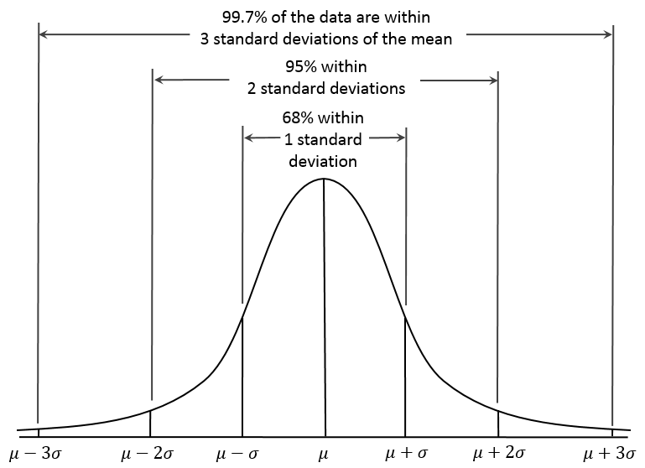
The 68-95-99 Rule

Slide 6
A Few Examples

Slide 7
Using “The Rule”
For a normally distributed variable with a mean of 12 and a standard deviation of 1, how much of the distribution is between 13 and 14 according to the rule?
.34
.34
.02
.13
.13
.02
12
13
14

Slide 8
Calculate the z-score
Always need three pieces of information:
Mu = 19
Sigma = 3
X =17
Z = (17 – 19) / 3
Z = -.066

Slide 9
Find sigma using the z-score formula
X = 22
Mu = 11
Z = 2.3
Plug it in, then re-arrange to find sigma
2.3 = (22 – 11) / sigma
2.3 sigma = 22 – 11
Sigma = (22-11) / 2.3
Sigma = 4.78

Slide 10
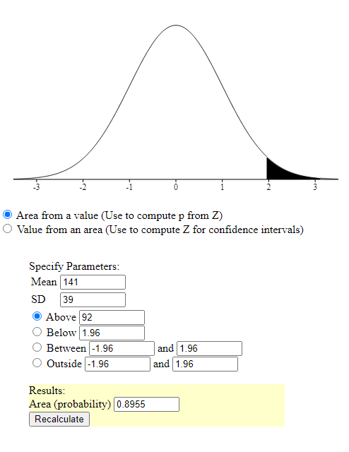
Z-tests
Use the applet!
What is the probability of randomly selecting a value above 92 for a distribution whose mean is 141 and sigma is 39?
p = .89

Slide 11
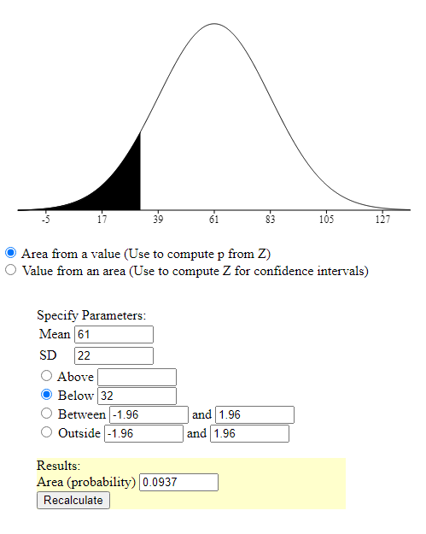
Z-tests
Use the applet!
What is the probability of randomly selecting a value below 32 for a distribution whose mean is 61 and sigma is 22?
p = .99

Slide 12
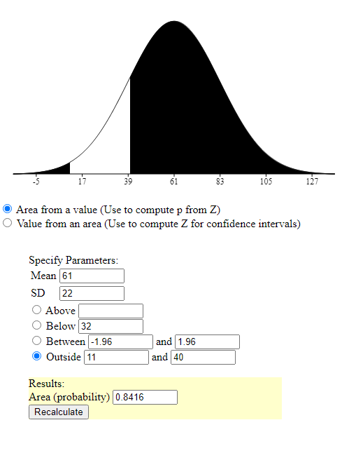
Z-tests
Use the applet!
What is the probability of randomly selecting a value that is less than 11 or greater than 40 for a distribution whose mean is 61 and sigma is 22?
p = .84

Slide 13
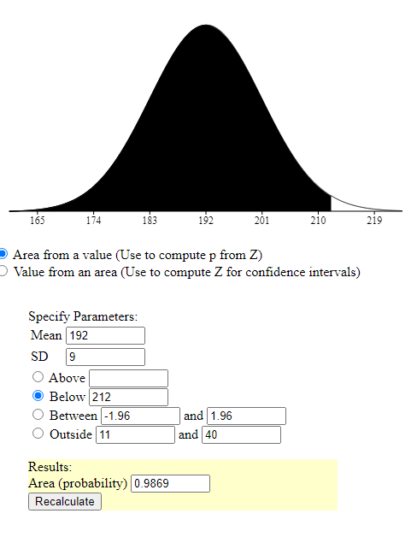
Score to a Percentile
You score a 212 on an exam, that has a distribution mean of 192 and a standard deviation of 9. What is your percentile?
99% percentile

Slide 14
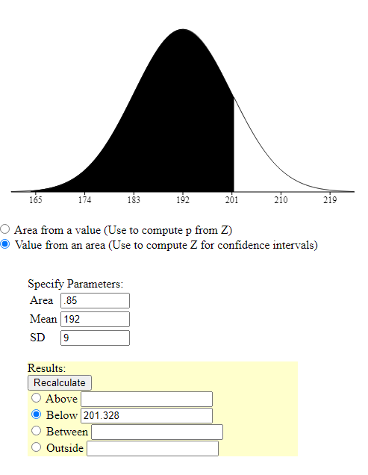
Percentile to a Score
You score in the 85th percentile on an exam with a distribution mean of 192 and a standard deviation of 9. What is your score?
Score of 201

